Slide 1
SIMPLIFYING THE BRAIN: A Vision for Neuroscience Research
V. Srinivasa Chakravarthy
Department of Biotechnology
IIT Madras.

Slide 2


“The number of neurons in the Brain are…
more than the number of stars in the Milkyway Galaxy.”

Slide 3


“The Brain is the most COMPLEX object in the Universe.”

Slide 4

Why the HYPE?

Slide 5



1. Large Projects

Slide 6
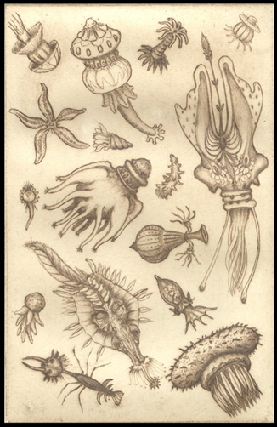
2. Descriptive tradition of Biology
Antoine von
Leeuwenhoek’s
Drawings of
“animalcules”

Slide 7

Can a biologist fix a radio?
Yuri Lazebnik, Can a biologist fix a radio?—Or, what I learned while studying apoptosis
Cancer Cell, 2012.

Slide 8
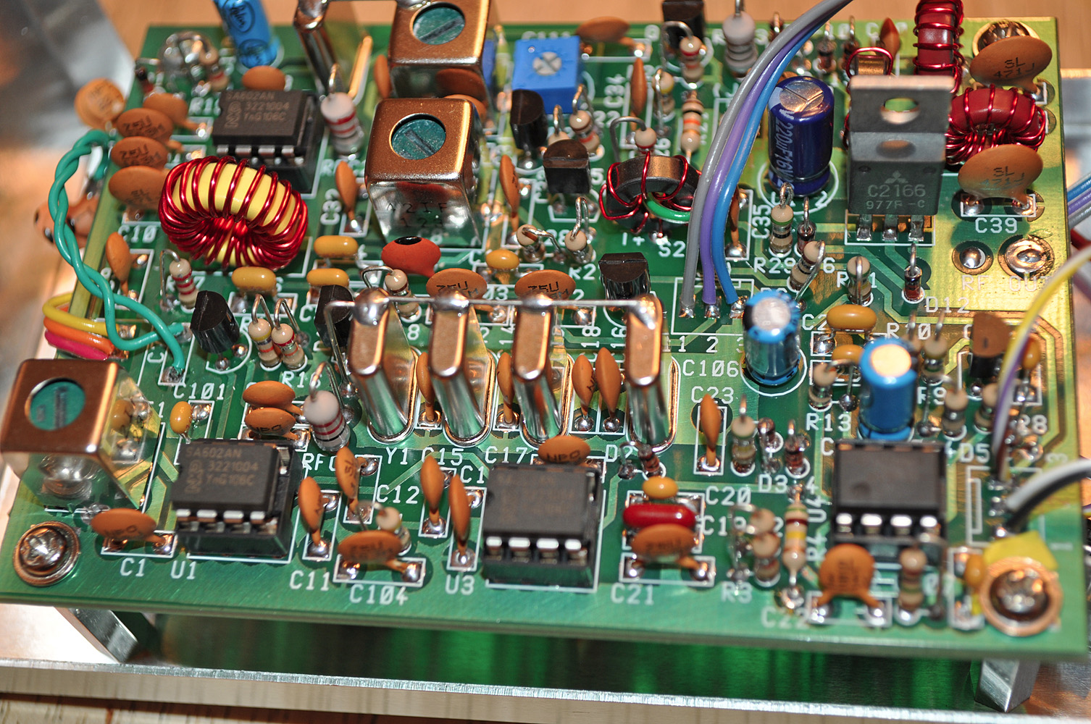

Slide 9

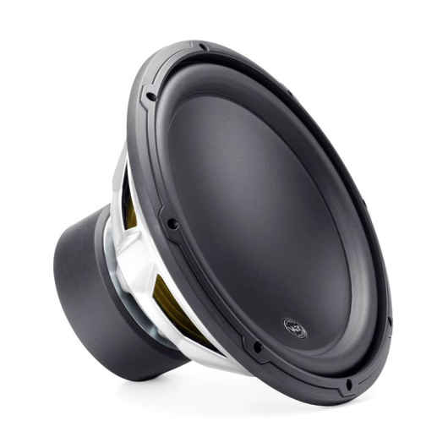
Architecture of a Radio
Tuner
Circuit
Demodulator
Amplifier
Antenna
Speaker

Slide 10

3. Big data …

Slide 11

DATA in modern world
Data as the fourth pillar of science
The first 3 pillars are:
Theory
Experiment
Computation

Slide 12
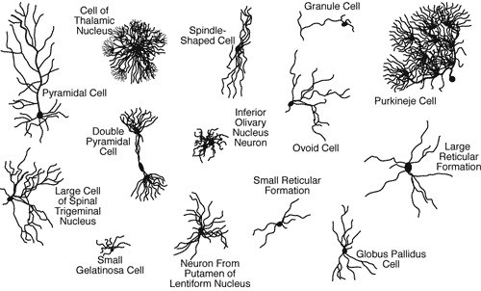
Neurons come in different Shapes

Slide 13
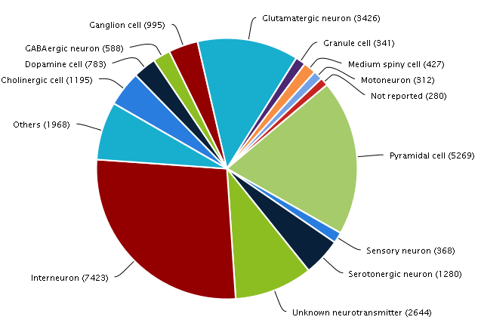
Neuromorph

Slide 14
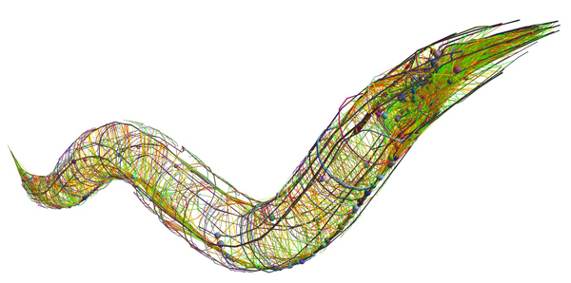
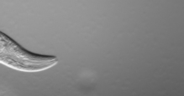
The Connectome Project
To find out the complete wiring diagram of the brain
Human brain
Has 100 billion neurons
Each neuron has about 1k-10k connections
Feasible for smaller organisms
C. Elegans connectome – 300 neurons, 7000 connections (White et al 1986)

Slide 15
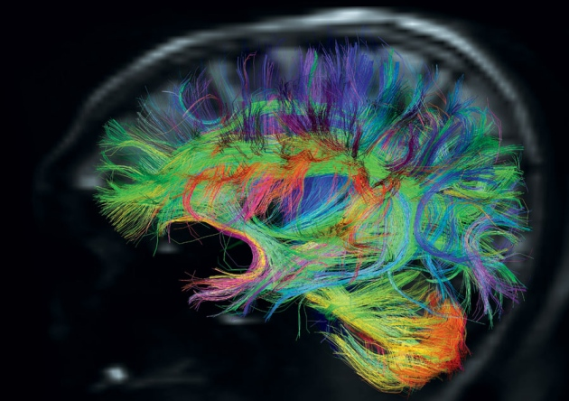
Human Connectome Project
- 1200 individuals
- fMRI + dMRI +
+ MRI + MEG
Washington U +
U. Minnesota
http://www.humanconnectome.org/

Slide 16
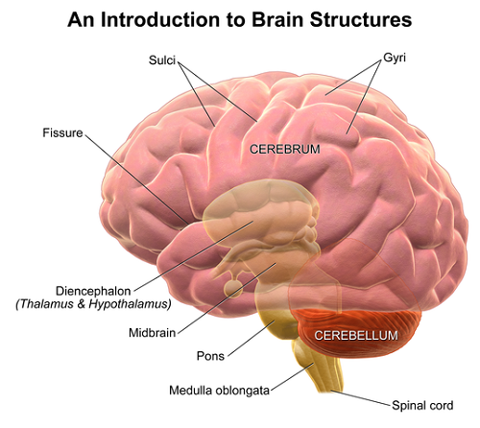
Why Connectome?
We don’t even know why:
There are two cerebral hemispheres?
There is a cortex?
Why the cerebellum is outside and thalamus inside?
What is the hurry
for the Connectome?

Slide 17
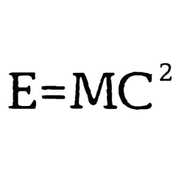
4. Big data …and tiny theory

Slide 18
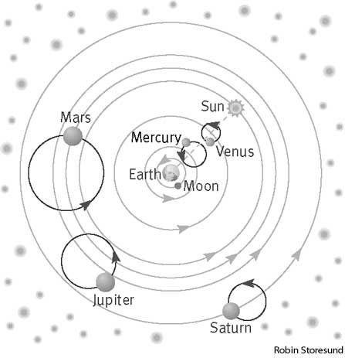
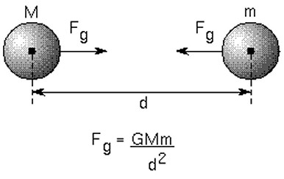
Analogy from the History of Astronomy
Ptolemaic Astronomy
Newtonian Astronomy

Slide 19
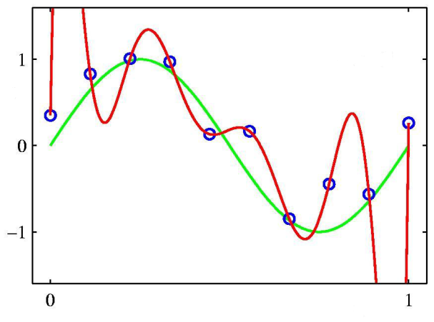

The Problem with Computational Modeling
More biology-style modeling
A thin wrapper over data
Less physics-style modeling
Need deep integrative theories
that relate diverse phenomena

Slide 20



Neuroscience is … theory weak
No satisfactory, comprehensive theory for most key brain structures
Verbal, hand-waving theories.
Thalamus is a relay station
Basal ganglia is a comparator
Neuroscience is… “data rich but theory poor.”
“We are at Faraday stage in neuroscience.”
VS Ramachandran
(Neuroscientist)
Patricia Churchland
(Neuroscientist)
Terry Sejnowski
(Neuroscientist)

Slide 21

4. The Problem of Reductionism
Systems
Neurons
Molecules
The futile attempt to explain everything in terms of molecules and cells.

Slide 22
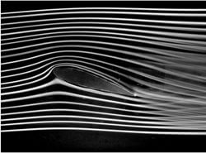
Engineering doesn’t work that way
Example:
Aircraft wing in a wind tunnel
Study fluid flow using Navier-Stokes Equation
FLUID is an abstraction
FLUID is NOT molecules

Slide 23
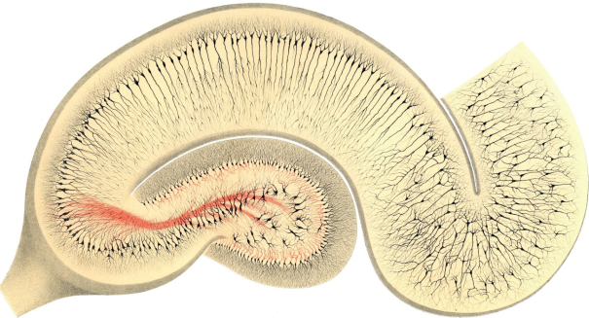
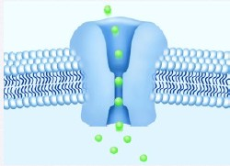
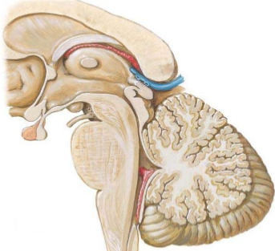
And therefore there is… Disproportionate Development
Rigorous understanding at
cell and molecular level
Inadequate understanding at
Systems Level

Slide 24

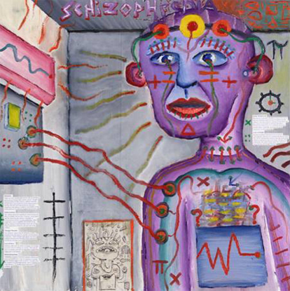
Lack of good theories of Multifactorial Diseases
Bipolar disorder
Schizophrenia

Slide 25


Contemporary Neuroscience
Basic Neuroscience
Clinical Neuroscience

Slide 26

There is a need to develop simplified models, embodying the right abstraction, the way it is done in physics and engineering

Slide 27
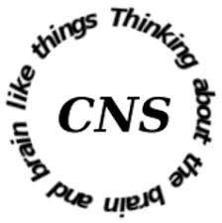

Two examples of Research@CNS Lab, IIT Madras
Computational Neuroscience
Modeling the Basal Ganglia
Modeling Hippocampus and spatial navigation

Slide 28
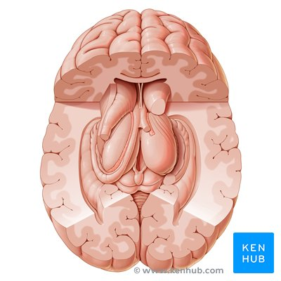
Cortex - Subcortex
Cortex
(Convoluted
Surface of the brain)
Subcortical
Structures
(interior regions
of the brain)
https://www.kenhub.com/en/library/anatomy/subcortical-structures-anatomy

Slide 29
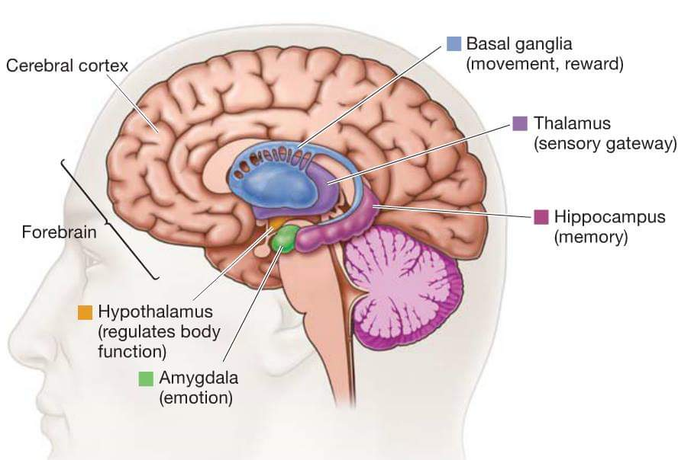
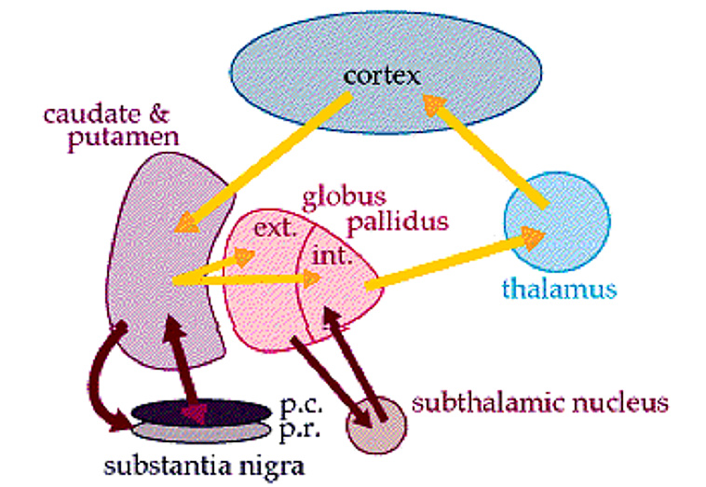
Modeling the Basal Ganglia
BG are a set of 7 deep brain nuclei
involved in several crucial brain functions.

Slide 30
Basal Ganglia and Reward Based Learning
Motor
Response
Sensory
Stimulus
Motor Cortex ← Sensory Cortex
BG
Dopamine (“Reward”)
Sensory-
motor State
SNc
BG interprets the reward and
Recommends the right action to the Motor Cortex

Slide 31
Functional anatomy of basal ganglia
Cortex
GABA/
Enkephalin
Glutamate
GPe
Striatum
Dopamine
GABA/
Substance p
GABA
Glutamate
SNc
STN
GPi
SNr
Glutamate
GPe – Globus pallidus external segment
GPi - Globus pallidus internal segment
STN – Subthalamic Nucleus
SNc – Substantia Nigra pars compancta
SNr – Substantia Nigra pars reticulata
GABA
Thalamus
Inhibitory
Excitatory
Cortex

Slide 32
BASAL GANGLIA FUNCTIONS
Action Selection
Sequence
Generation
Motor Preparation
Goal-directed behavior
Reward Based Learning
Working Memory
Timing
Exploratory Behavior
(Chakravarthy et al 2010)
“The mysterious motor functions of Basal Ganglia…” – Marsden (1982)

Slide 33
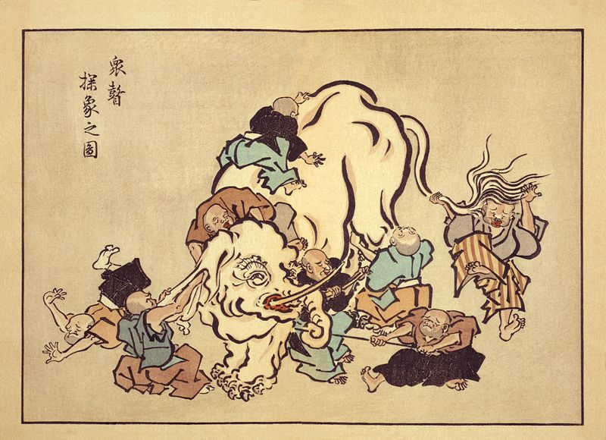

Slide 34
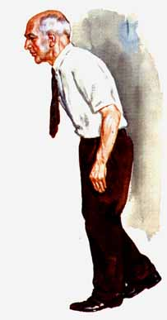
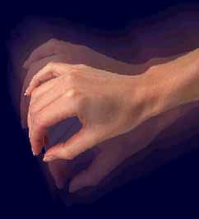
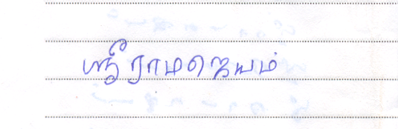
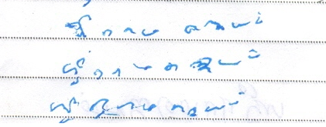
Parkinson’s disease (PD)
Progressive neurodegenerative disorder
Pathology: loss of dopaminergic neurons Substantia nigra pars compacta (SNc)
Cardinal Symptoms:
Tremor,
Rigidity,
Postural abnormalities,
Bradykinesia.
Motor symptoms in many modalities:
Reaching movements
Handwriting
Eye movements
Speech
Posture…
Normal Handwriting
PD handwriting

Slide 35
The Classical View of BG Function

Slide 36
The Direct & Indirect Pathways
(Albin et al 1989)
GPi
Stn
Indirect
Pathway
(“NoGo”)
Low DA
Direct
Pathway
(“Go”)
High DA
GPe
Str
SNc
DA
“NOGO”
δ₀
“GO”

Slide 37
Dopamine (DA) for fun
Brain’s “pleasure chemical”
DA release is triggered by brain stimulation, psychomotor stimulants, opiates, and food (Wise & Rompre 1989)
DA antagonists attenuate the pleasurable experience of the above (Wise & Rompre 1989)
Beautiful faces (Aharon et al 2001), images of lovers (Aron et al 2005), monetary rewards (Thut et al 1997) trigger the dopamine reward system

Slide 38
Rewards and Learning by Reinforcement
Reward (+ve reinforcement)
Stimulus
Response
Learn It
Punishment (-ve reinforcement)
Stimulus
Response
Don’t Learn It

Slide 39
Basal Ganglia and Reward Based Learning
Motor
Response
Sensory
Stimulus
Motor Cortex ← Sensory Cortex
BG
Dopamine (“Reward”)
Sensory-
motor State
SNc
BG interprets the reward and
Recommends the right action to the Motor Cortex

Slide 40
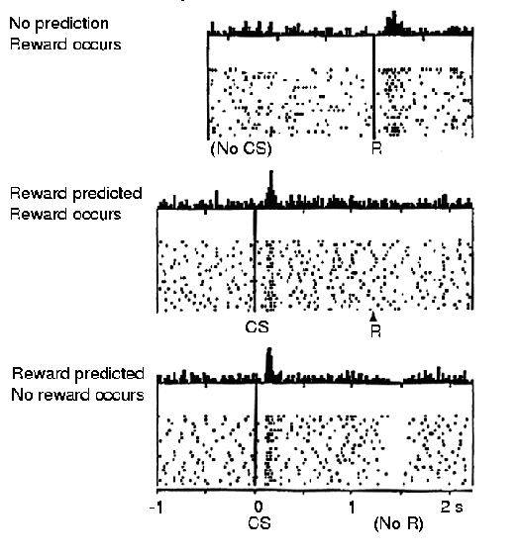
DOPAMINE AS A REWARD-RELATED SIGNAL
Schultz et al, 1997
DA = total actual future reward – total expected future reward

Slide 41





BG and Action selection
reward
punishment
Experience
(rewards/punishments)
Shapes the
Probability of choosing
An Action
+
-

Slide 42

BG and Action selection
Initial stage
Choose
Yellow
- “Value”: Reward-giving
potential of an Action
Both values are equal
Initially.

Slide 43
BG and Action selection
Reward
Choose
Yellow
Yellow fetched Reward
+

Slide 44
BG and Action selection
Reward
Choose
Y
+
“Value” of Yellow is
Increased

Slide 45
BG and Action selection
Initial stage
Choose
Y
“Value”: Reward-giving
potential of an Action

Slide 46
BG and Action selection
Choose
Red
“Value”: Reward-giving
potential of an Action

Slide 47
BG and Action selection
Punishment
Red resulted in
Punishment
-

Slide 48
BG and Action selection
Punishment
Reward → GO
Punishment → NoGo
-
“Value” of Red is
reduced.

Slide 49

The need for exploration
reward
punishment
reward/or
punishment?
GO
NOGO
EXPLORE
+
-
Shall I check this one out?

Slide 50
Components of reinforcement learning
Reward signal
“Values”
Exploration
Actions
State

Slide 51

RL components in basal ganglia
Actions (Yellow or Red?)
Direct
Pathway
(“Go”)
GPi
Stn
Indirect
Pathway
(“NoGo”)
GPe
Striatum
Dopamine
(Reward/punishment)
“Values” are stored here!
SNc
(State)

Slide 52
The Classical View of BG: The GO/NOGO model
Indirect
Pathway
(“NoGo”)
Low DA
Direct
Pathway
(“Go”)
High DA
Go
NoGo
(Albin et al 1989)
SNc
Dopamine

Slide 53
The Direct & Indirect Pathways
-
GPi
+
Stn
Indirect
Pathway
Direct
Pathway
-
+
-
GPe
-
Str
SNc
DA
STN-GPe LOOP:
Exhibits complex dynamics
(Terman et al 2002)

Slide 54
An alternative View of BG: The GO/EXPLORE/NOGO model
Explore
Indirect
Pathway
Direct
Pathway
Go
NoGo
SNc
Dopamine
NOGO
EXPLORE
GO
(Chakravarthy et al 2010)
DA

Slide 55
A simple model of basal ganglia
(Chakravarthy & Priyadarshini,
Encyc. of Computational Neuroscience, 2014)

Slide 56
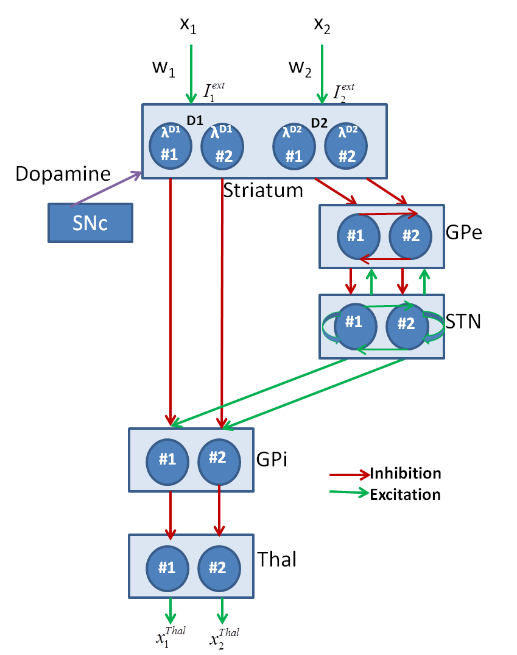
A Schematic of the Model

Slide 57
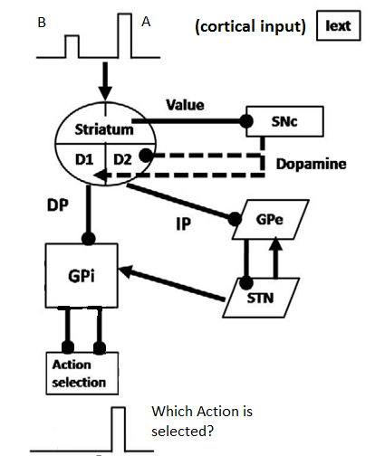
Classifying Action Selection Regimes
Cortical input presents
Two Competing Actions:
A and B (A > B)
Action Selection at Thalamus:
Selection Regime DA
A GO HI
NONE NOGO LO
B is selected EXPL MED

Slide 58
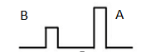
Striatum Model
GPi
GPe
D1 D2
MSNs
D1 MSNs
D2 MSNs
DA(δ)
Cortico
Striatal
connections
DA
DA
I_{ext}
I_{ext}
I_{ext}
D1 and D2 are the Hopfield 1D neuron layers

Slide 59
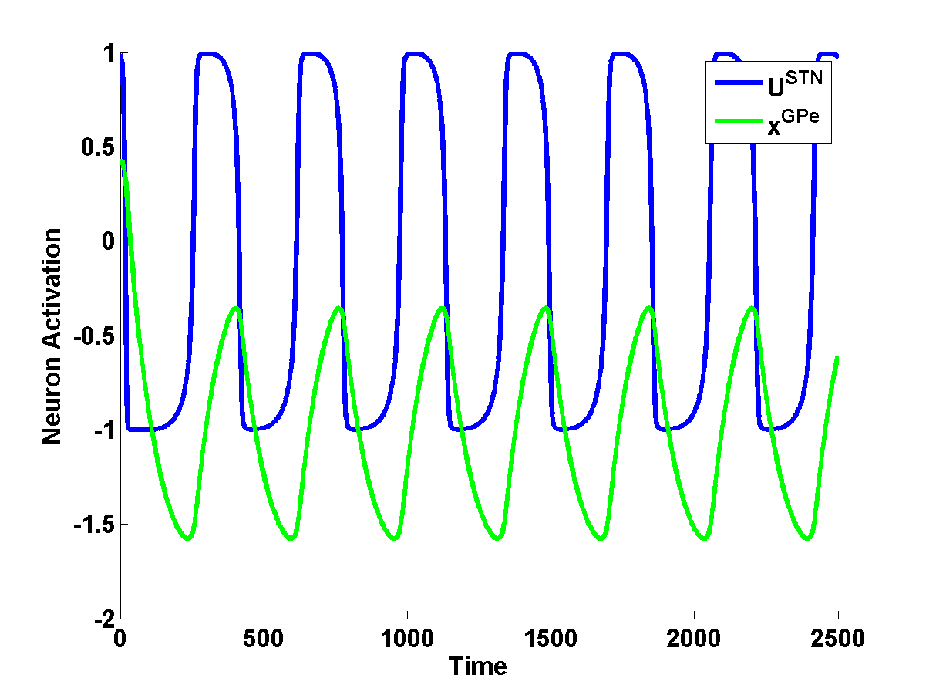
STN-GPe Model
σ
I_{HDP}
STN
w
-
+
w
GPe
σ
I_{D2_STR}
Modeled as excitatory-inhibitory pair of 1D-neural layers
One to one connections between STN and GPe
Lateral connections (fully connected) within STN and Gpe
Strong w and weak σ produces chaos (Kalva et al 2012)
Increased I_{D2_STR}, increased I_{HDP}, or decreased DA → STN-Gpe induces oscillations (Magill et al 2011; Kumar et al 2011)

Slide 60
Summation at GPi
GPi combines the GABAergic striatal outflow via DP with glutamatergic STN output from IP.
The combination of DP and IP outflows in GPi is modulated by dopamine projections.
Thalamus
U_{GPi}
λ^{D1} (δ_{V})
λ^{D2} (δ_{V})
#1
#2
δ_{V}
GPi
SNc
(Kliem, Maidment et al. 2007)
STN
Striatum
(Value)
Inhibition
Excitation
Notes:
Kliem et al (2010) show that when D1 receptors in GPi, which are primarily located on the axons of GABAergic striato-pallidal projections, are activated, firing levels of GPi neurons are reduced (Kliem, Maidment et al. 2007).

Slide 61
If
Action Selection in Thalamus
Motor cortex
#1
#2
Thalamus
If (x_{i}(t) > x_{th}) for some i, at some time t,
- Select ‘i'th action
- Reset all other thalamic neurons.
I_{GPi}
61

Slide 62
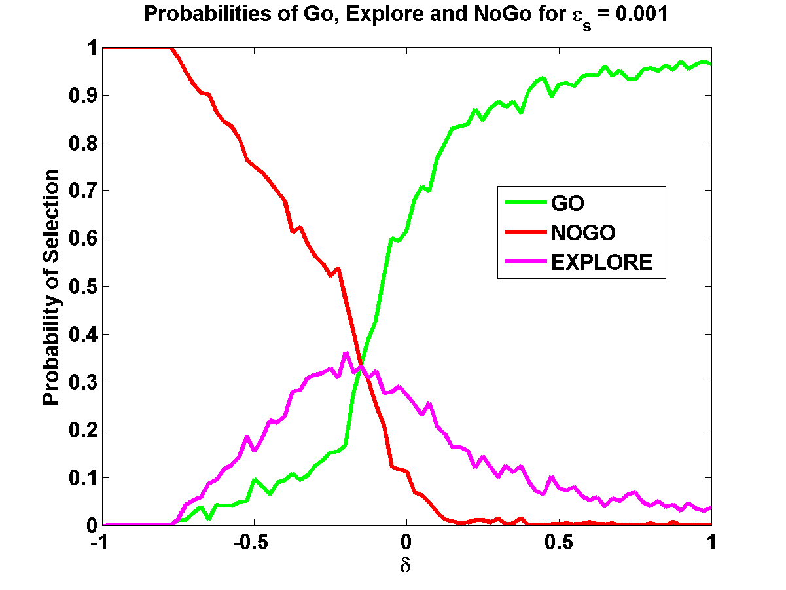
Binary Action Selection
62

Slide 63
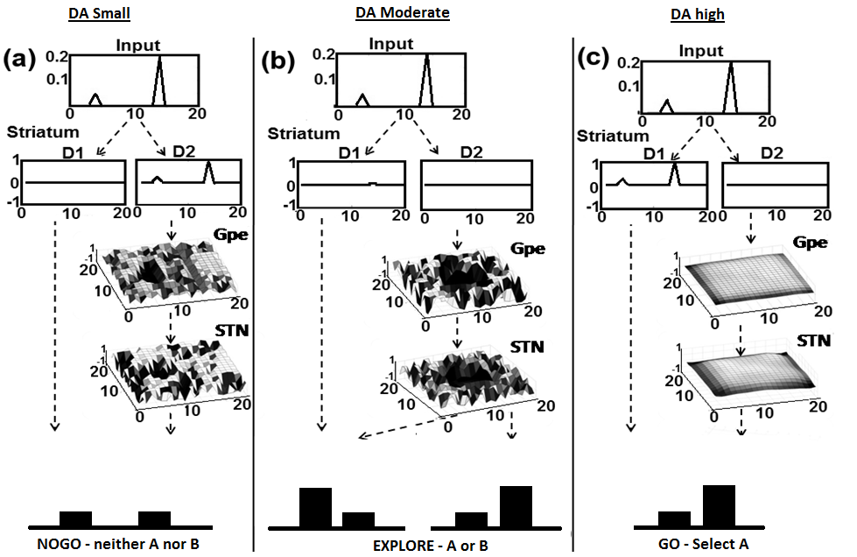
Effect of DA level on Action Selection
DA low
DA med
DA high

Slide 64
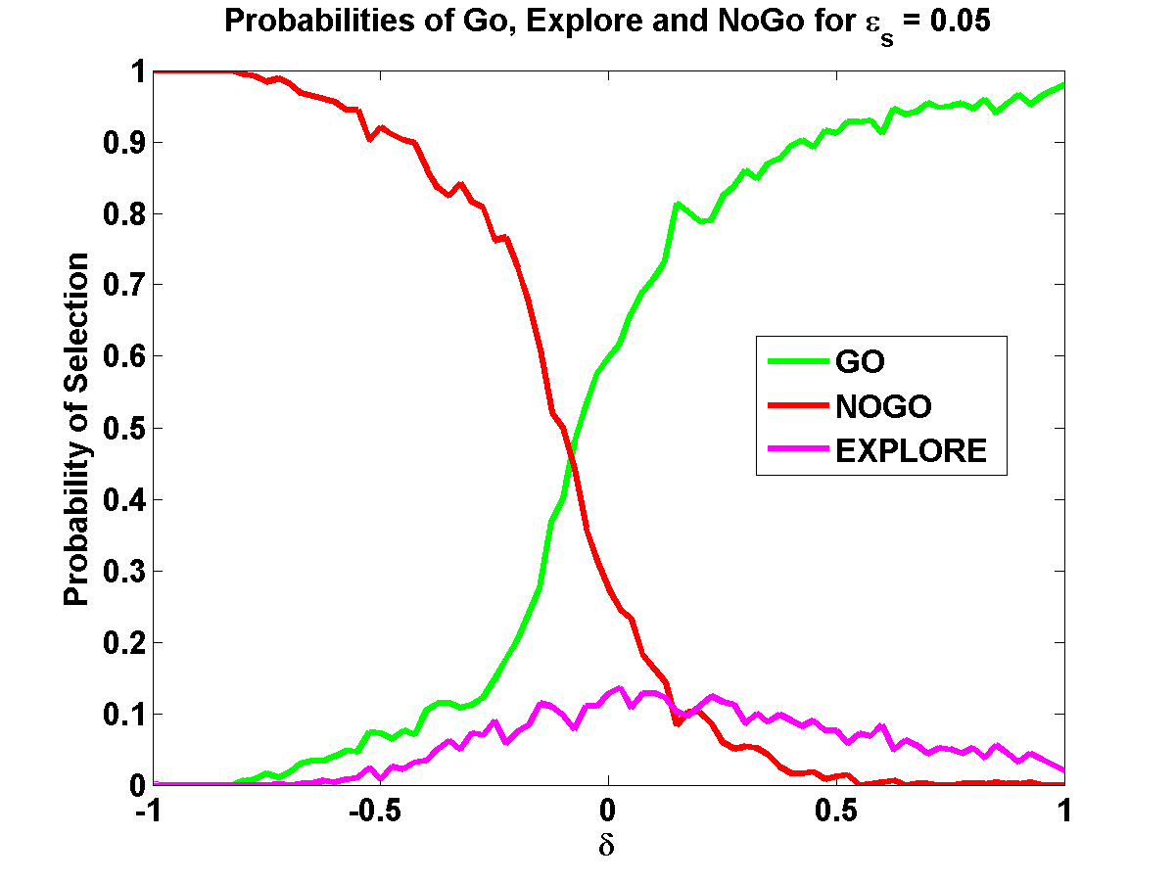
Effect of STN-GPe dynamics on Action selection
ε_{s} = strength of lateral conns in STN
Stronger STN laterals
→ more synchrony in STN-GPe oscillations
ε_{s} = 0.001
ε_{s} = 0.95

Slide 65
The Three Regimes of BG dynamics
(The Classical picture talks of only two regimes: GO and NOGO)

Slide 66
Modeling the motor functions of BG
Basal ganglia
Handwriting
Spatial
Navigation
Normal | PD
Reaching
Saccade
Generation
Gait
Risk
Precision
Grip
DBS
Birdsong
Moustafa et al 2016
Balasubramani et al 2015a
Helie et al, Front. CN, 2014
Balasubramani et al, Front. CN, 2014
Gupta et al, Front. CN, 2014
Sukumar et al, PLoS One 2012
Kalva et al, Neural Netw 2012
Magdoom et al, Neural Comp, 2011
Krishnan et al, Neural Netw., 2011
Chakravarthy et al, Biol Cyb, 2010
Mandali et al, 2015
Balasubramani et al 2015b
Chakravarthy & Balasubramani, 2014
Muralidharan et al, Front CN, 2014
Chakravarthy, PLoS One, 2013
Maya et al, IJBMC, 2012
Joseph et al, Neurocomp, 2010
Gangadhar et al, Hum Mov Sci, 2009
Gangadhar et al, Neural Comp., 2008
Deverajan et al, IJNS, 2006

Slide 67
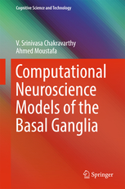

Slide 68
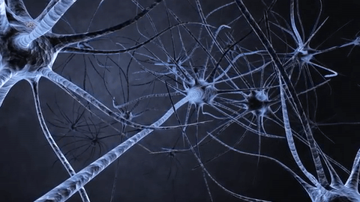
A Biologically plausible computational model of Hippocampal Spatial cells

Slide 69
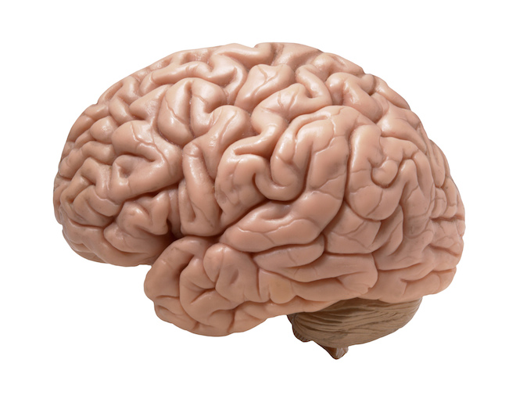



Slide 70


Slide 71
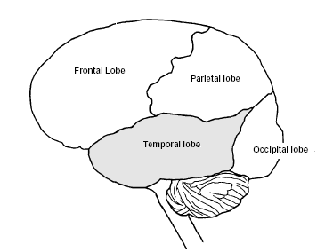
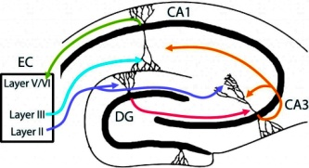
Where is the spatial map of the world in the brain?

Slide 72
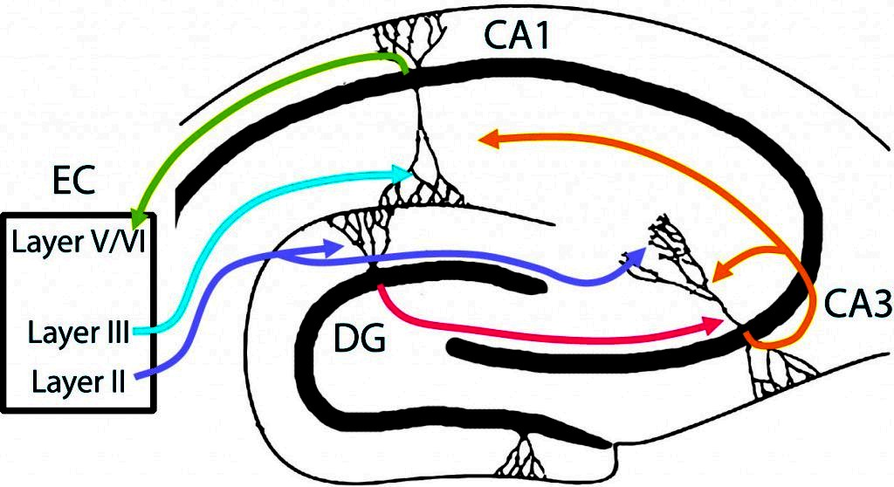
Organization of Hippocampus
Moser EI, Roudi Y, Witter MP, Kentros C, Bonhoeffer T, Moser M-B. 2014. Grid cells and cortical representation. Nature Reviews Neuroscience 15(7):466-481.

Slide 73
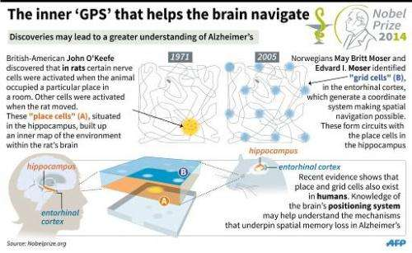
https://phys.org/news/2014-10-nobel-importance.html

Slide 74
Neural correlates of navigation
Place cells
Grid cells
Head direction cells

Slide 75
Place cells
Neurons that fire when the animal is at a specific place of the environment.
Place of firing of the cell is known as is its firing field.
Discovered by John O’Keefe and Dostrovsky in 1971. (O’Keefe was awarded Nobel prize for this discovery in 2014)
O'Keefe J, Dostrovsky J. 1971. The hippocampus as a spatial map. Preliminary evidence from unit activity in the freely-moving rat. Brain research 34(1):171-175.

Slide 76
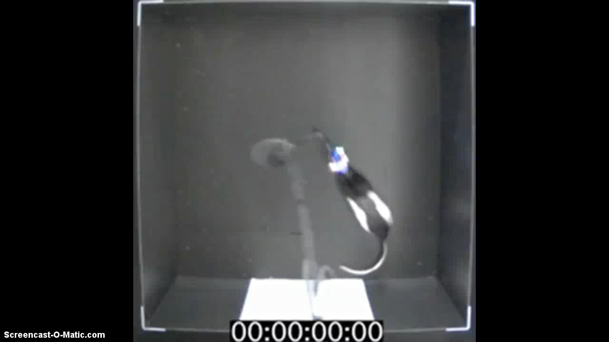

Slide 77
-Network architecture-
Soman, K., Muralidharan, V., Chakravarthy, V.S., Eur. Jnl. Neuroscience, (2018).

Slide 78
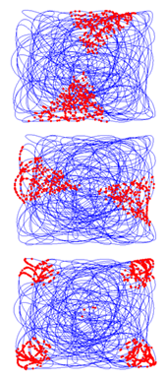
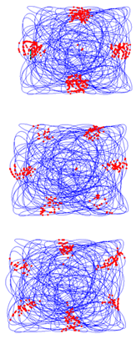
-Results-
1
4
2
5
3
6

Slide 79
Model architecture
Unsupervised Neural
Network
Oscillatory
Dynamics
Direction Representation

Slide 80
Spatial representations of LAHN_{SC} neurons
Firing Field
Firing Rate map
Autocorrelation map
LAHN_{SC}
PI Layer
HD SOM
Limb oscillations

Slide 81
Spatial representations of LAHN_{PC} neurons
Soman, Muralidharan and Chakravarthy, IEEE Trans. Cog. & Dev. Sys. (2017)

Slide 82
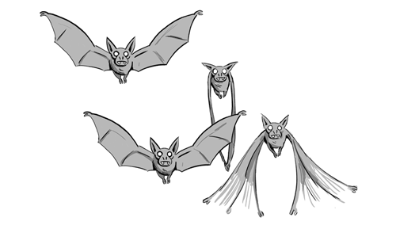
3D navigation in Bats - A Computational model
Soman, K., Chakravarthy, S., & Yartsev, M., Nature Communications (2018).

Slide 83
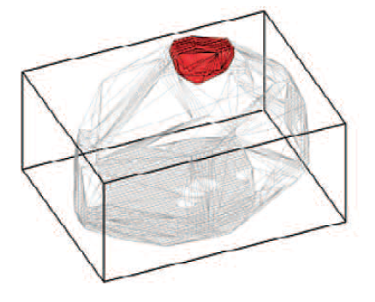
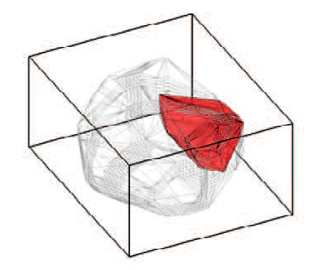
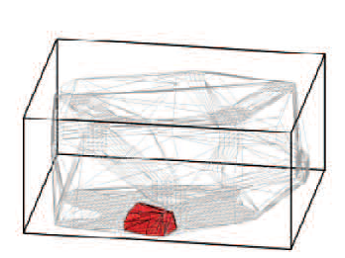
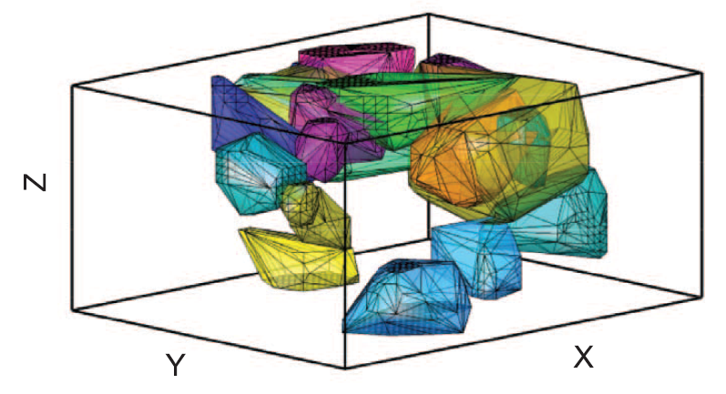
3D Place cells
Coding for the volume of space
Isotropic in its shape
Uniformly distributed across the space
Absence of theta rhythm in hippocampal LFP
Yartsev, Michael M., and Nachum Ulanovsky. "Representation of three-dimensional space in the hippocampus
of flying bats." Science 340.6130 (2013): 367-372.

Slide 84
Model architecture
Spatial cell
stage
PCA
weights
Low frequency oscillatory stage
Direction encoding stage
Azimuth angle
Pitch angle

Slide 85
Place cells
Place cell 1
XY
YZ
XZ

Slide 86
“Plane” cells
XY
YZ
XZ

Slide 87
“Stack” cells
XY
YZ
XZ
Goodness of Fit
R² = 0.7484 (upper plane)
R² = 0.8206 (lower plane)

Slide 88
Summary
First network level modeling approach to 3D spatial navigation.
Model captured the empirically reported 3D place cells.
Model predicted the existence of new cell types: Plane cells and Stack cells

Slide 89

The Road Ahead…

Slide 90
NEUROSCIENCE EDUCATION

Slide 91

“Principles first” Approach
PRINCIPLES
DETAILS
DETAILS
DETAILS

Slide 92


Slide 93
To
Medicine/Biology
Community.
Without math
To
Engineers/
Physicists
Without
Biology jargon

Slide 94
Table of Contents
1. Brain ideas through the centuries
2. Brain – through the aeons
3. The world at the level of a neuron
4. Networks that learn
5. Memories and holograms
6. Maps, maps everywhere
7. Pathways of Light
8. Feeling the world
9. Life in motion
10. Circuits of emotion
11. A gossamer of words
12. The stuff that minds are made of

Slide 95

NPTEL COURSE DEMYSTIFYING THE BRAIN

Slide 96
AN APPROACH TO BRAIN modelLiNG
NEUROSCIENCE RESEARCH
SIMPLIFY - UNIFY - APPLY

Slide 97


SIMPLIFY: Simplify the model to the point that any further
simplification will make the model absurd.

Slide 98





2. UNIFY: Explain a wide range of experimental data
using the same model

Slide 99


3. APPLY: Using the unified model develop applications in…
CLINICAL NEUROSCIENCE
ENGINEERING

Slide 100

Modeling the Whole Brain
Adult human brain: 100 billion neurons
Proposed model: 10 million neurons (approx)
(Wiki)

Slide 101


Slide 102

INTEGRATED APPROACH
Create interdisciplinary teams that take an ENGINEERING APPROACH To NEUROSCIENCE

Slide 103

“They who behold the One,
In all the changing manifoldness
Of the universe,
Unto them belongs the eternal truth,
Unto none else, unto none else.”
JAGADIS CHANDRA BOSE
(1858-1937)
Thank you

